Slide 1

“E-VOTING SYSTEM” A Major Project Presentation submitted in partial fulfillment for the award of the Degree of Bachelor of Technology in Department of Computer Science & Engineering (with specialization in Computer Engineering)
Supervisor: Submitted By:
Mr. Girish Sharma Akash Singh
Sr. Lecturer Mukul Mathur
Department of Computer Science & Engineering Nitin Sethi
Vishal Chauhan

Slide 2
Contents
Introduction
Current System
Scope of Project
Tools used
UML Diagrams
Advantages
Limitations
Conclusion

Slide 3
Introduction
The E-Voting System enhances the whole voting process.
The voter can cast the vote from anywhere.
The system provides the threat free and user oriented voting.
The system also easily analyze the results quickly.
The vote can be casted from any multimedia device which have internet connection.
The system supports devices like PCs, laptops, Smartphones, etc.

Slide 4
Current System
Many problem are faced by the people in voting manually
Time required is more
Cases of capturing of voting booth occurs
Result analysis is time consuming

Slide 5
Scope of Project
It is focused on studying the existing system of voting and make sure that the peoples votes are counted accurately.
This will also produce
Less effort and less labour intensive
Increasing the number of voters as the system provides a too convenient and easier way to vote.

Slide 6
Tools Used
IBM Rational Software Architect
Notepad++
Eclipse Juno
MySQL
Apache Tomcat
Microsoft Word

Slide 7
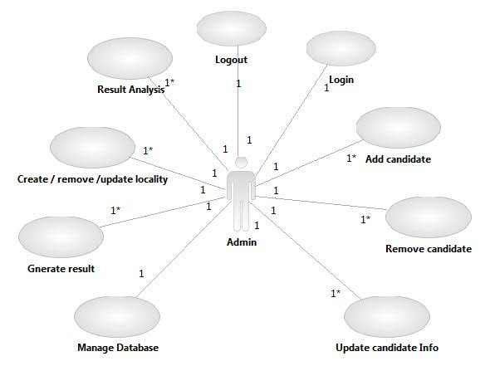
UML DIAGRAMS
Admin Use Case

Slide 8
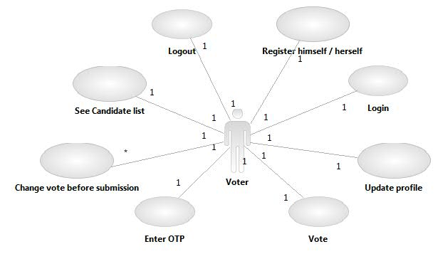
Use Case Contd…
Voter Use Case

Slide 9
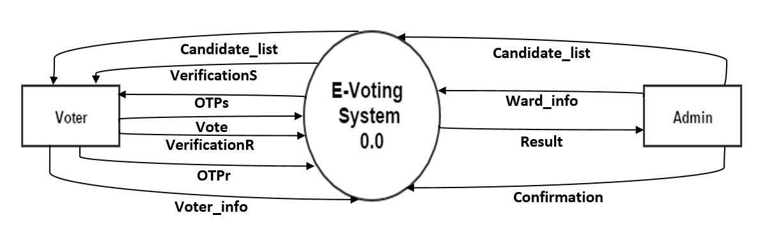
DFD
0 level DFD

Slide 10
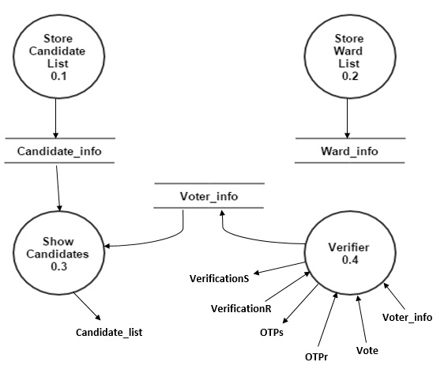
DFD Contd…
1 level DFD

Slide 11
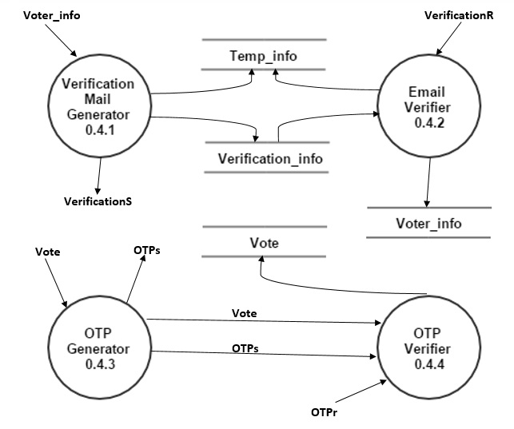
DFD Contd…
2 level DFD

Slide 12
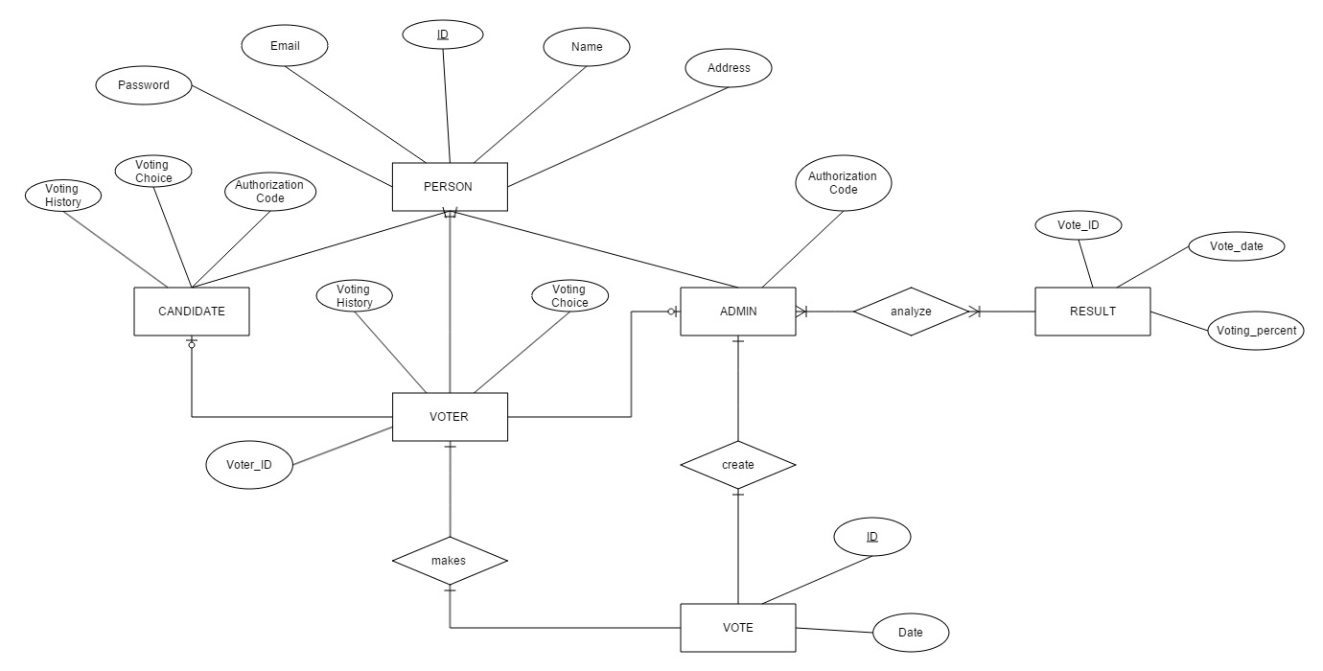
ERD

Slide 13
Advantages
Unique Identification of voter
Accurate vote counting
Portable
Less chances of involving of fraud voters
Increases the participation of voters

Slide 14
Limitations
Internet dependent
Chances of electronic failures
All generation may not be comfortable

Slide 15
Conclusion
Generally voting is performed by the voter by going to the voting booth, which is not possible for people serving in other state or in armed forces.
Therefore this system is developed by us by implementing the whole voting procedure online. So that people can vote from anywhere by just using there browser and by having internet connection.

